Slide 1
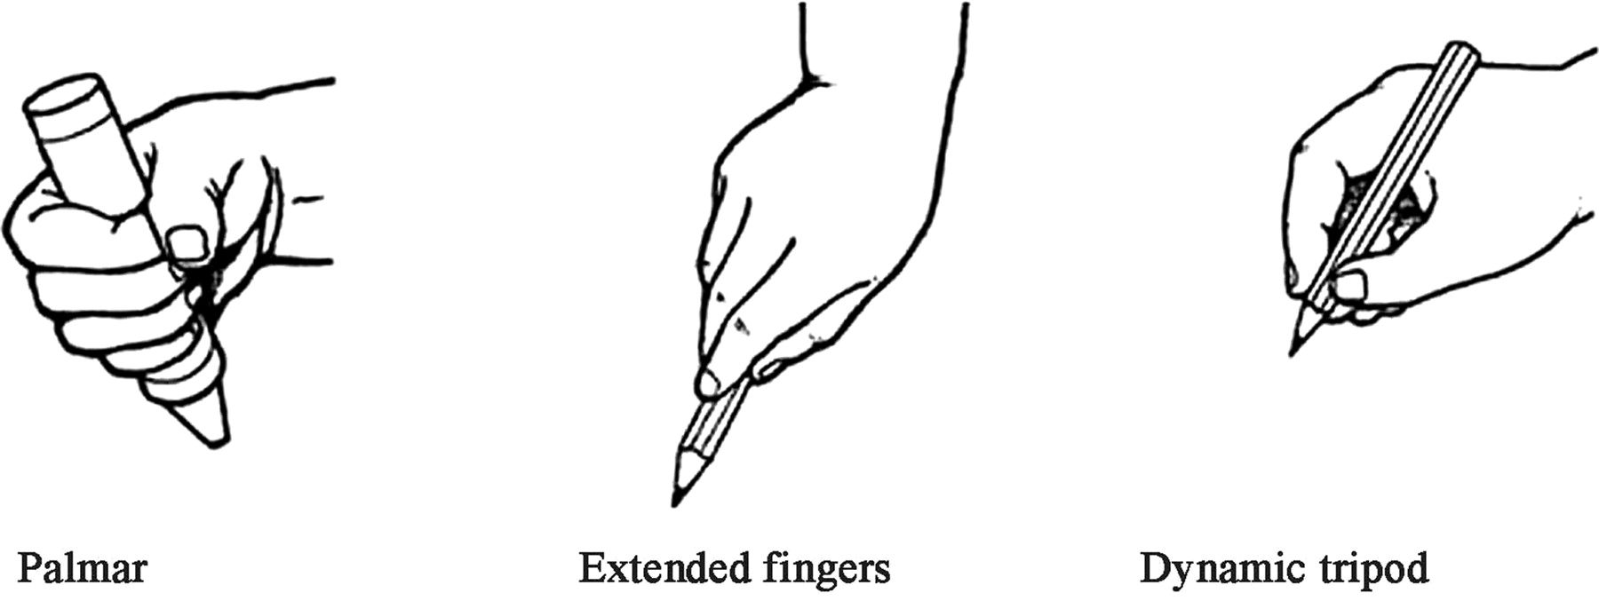
DNA
2. What Grasp is missing?
3. What age would a child use the pincer grasp?
1. Name the 2 grasps?
Notes:
Answesr – 1. Palmar and tripod. 2 Pincer 3. 9 months

Slide 2
Characteristics of child development
Unit 1 – exam component

Slide 3
Learning aim a
TASK 1: Creating a class timeline of milestones (piles)
(4 groups)
Group1: 0-12 months
Group 2: 15 months to 3 years
Groups 3: 3- 5 years
Groups 4: 5- 8 years

Slide 4
Example group 1- (0-12 MONTHS)
0-12 Months | Physical – gross motor | Physical – fine motor | Intellectual- cognitive | Language | Emotional |  | Social
Birth | reflexes | No co ordination | Freezes to sounds
3 months | Lift head | Watch hands and hold a rattle | Recognise routines- alert follows movements with eyes
6 months | Roll front to back | Reach for a toy – one hand to the other | Explore objects-put in mouth
9 months | Sit un supported | Pincer grasp | Look for dropped objects
Notes:
Each group take a life stage and map out the PILES

Slide 5
BRINGING IT ALL TOGETHER
Present the work
Notes:
All groups bring their timelines together and display- discuss other ways of remembering

Slide 6
Practice exam questions using timelines

Slide 7
homework
Complete the PILES aid memoir

